Slide 1
Tangyuan 汤圆
Chinese dessert made from glutinous rice flour mixed with water to form balls (and sometimes with peanut, or sesame filling) and served in boiling water (or in peanut soup)
Eaten due to the homophone for union: 团圆
Eaten together with family: symbolize family togetherness.
Eaten during the Lantern Festival, but also taken as part of a wedding tradition. Now, due to the ease of mass production, they are eaten all year round.
Personal: Previously used to be a time-consuming gesture, wrapping done by female members of the family. Because it can be bought from the supermarket, there is less enthusiasm for the family members to make them by hand.

Slide 2
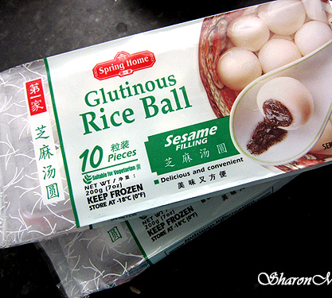
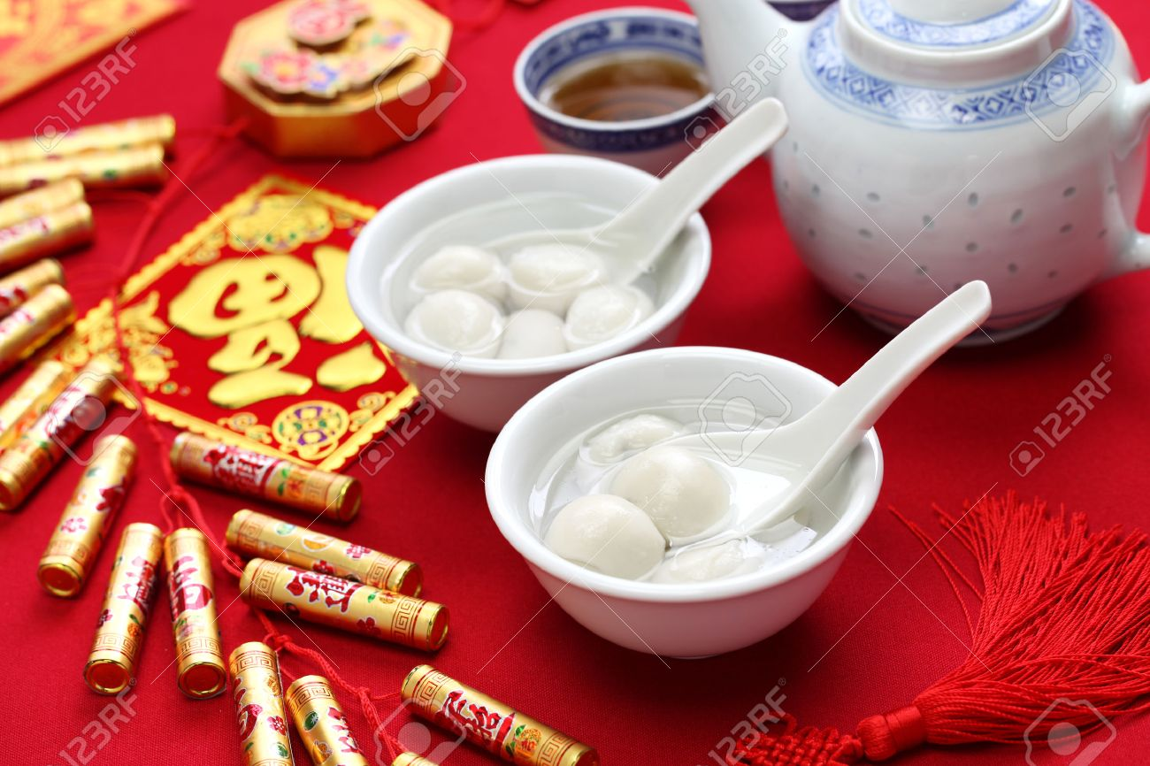
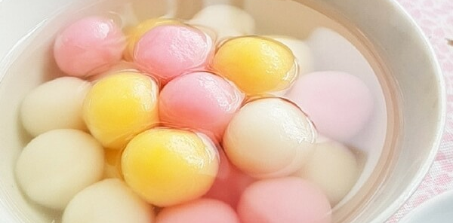
Different occasions in which tangyuan is being consumed.

